Slide 1
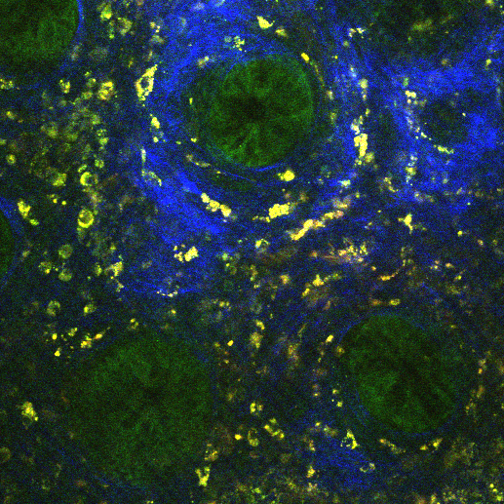
A
C
B
ç
D
10 µm
E

Slide 2
300
X
Y
P_{o}
C₁
C₂
C₃
Image
X
Y
P_{o}
C₁
C₂
C₃
X
Y
P_{o}
C₁
C₂
C₃
X
Y
X
P_{o}
Y
C₁
C_{o}
C₂
P₁
C₃
P₂
P₃
X
Y
P_{o}
C₁
C₂
C₃
300
X
Y
P_{o}
C₁
C₂
C₃
X
Y
X
P_{o}
Y
C₁
P_{o}
C₂
C₁
C₃
C₂
C₃
X
Y
P_{o}
C₁
C₂
C₃
X
Y
P_{o}
C₁
C₂
C₃
X
Y
X
P_{o}
Y
C₁
P_{o}
C₂
C₁
C₃
C₂
C₃
X
Y
P_{o}
C₁
C₂
C₃
X
Y
P_{o}
C₁
C₂
C₃
X
Y
P_{o}
C₁
C₂
C₃
30 x 30
1
.5
X, Y coordinate ⊂[0,1]
0
0
.5
1

Slide 3
A
B

Slide 4
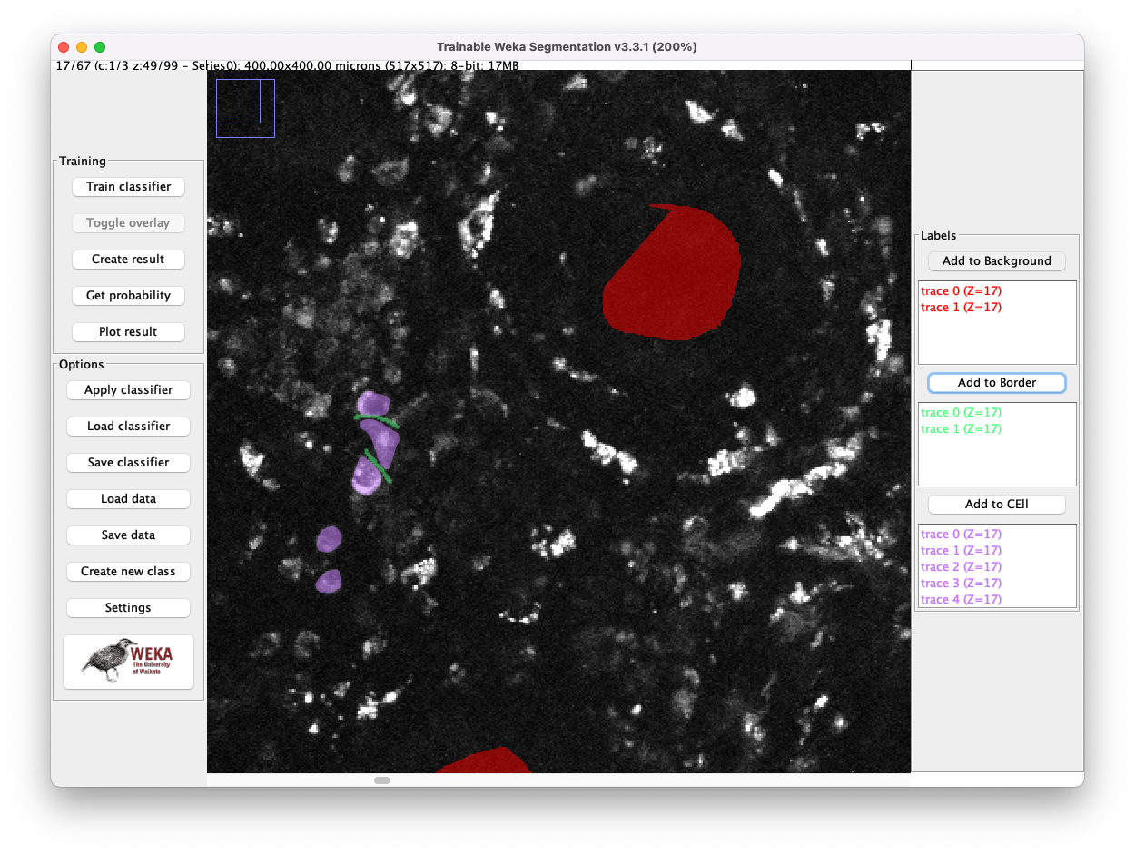
A
B

Slide 5
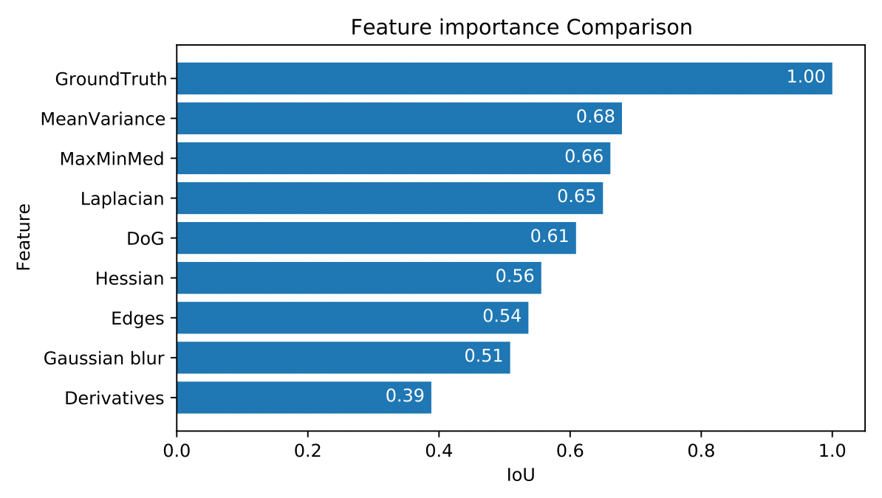
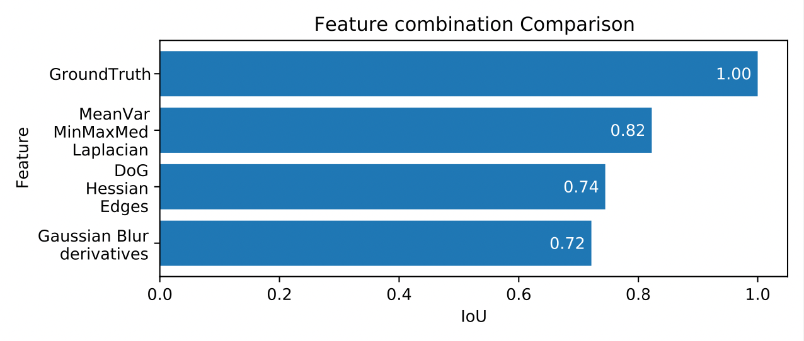
A
B

Slide 6
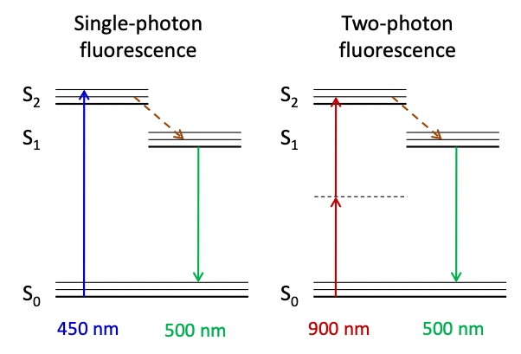
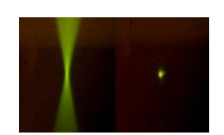
A
B
1 PE
2PE

Slide 7
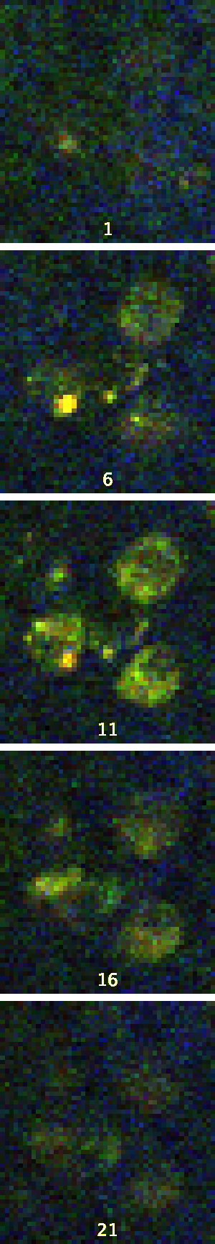
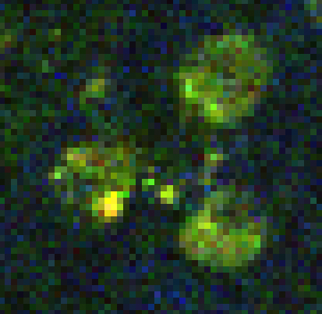
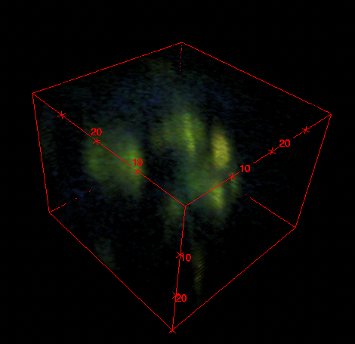
a
b
c
1 $μm$
6 $μm$
Z
X
11 $μm$
Z
Y
X
Y
16 $μm$
21 $μm$

Slide 8
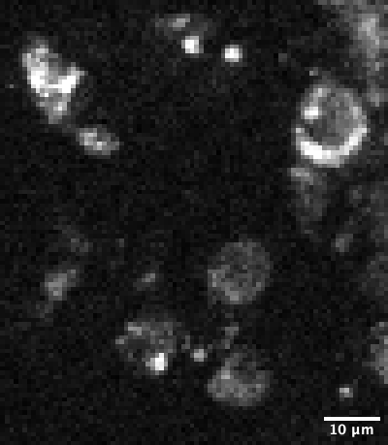
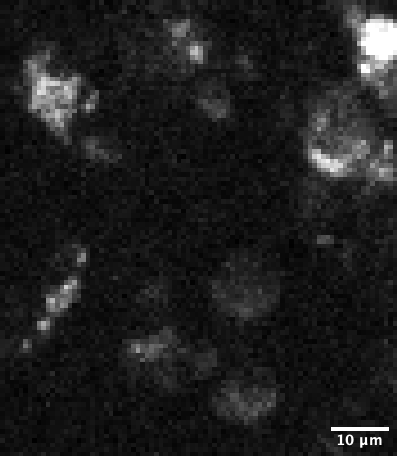
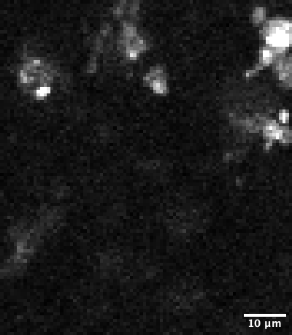
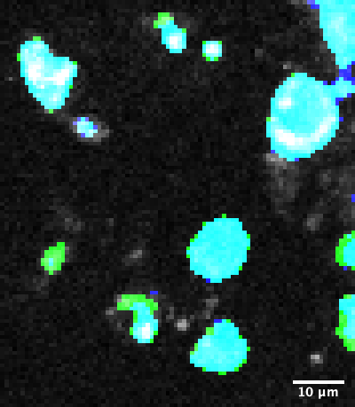
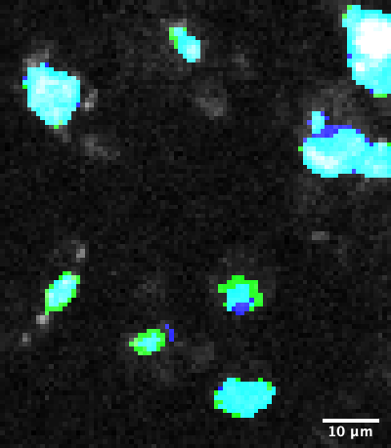
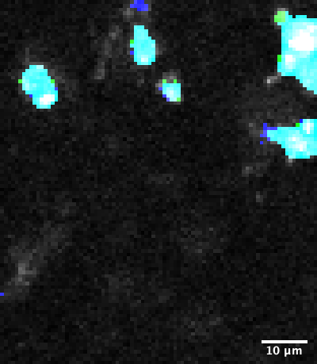
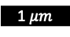
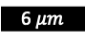
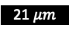
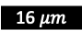
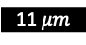
A (z = 0 µm)
B (z = 7 µm)
C (z = 14 µm)
1 $μm$
Intensity
6 $μm$
Ground truth
11 $μm$
Prediction
Intersection
Mask overlay
16 $μm$
21 $μm$

Slide 9
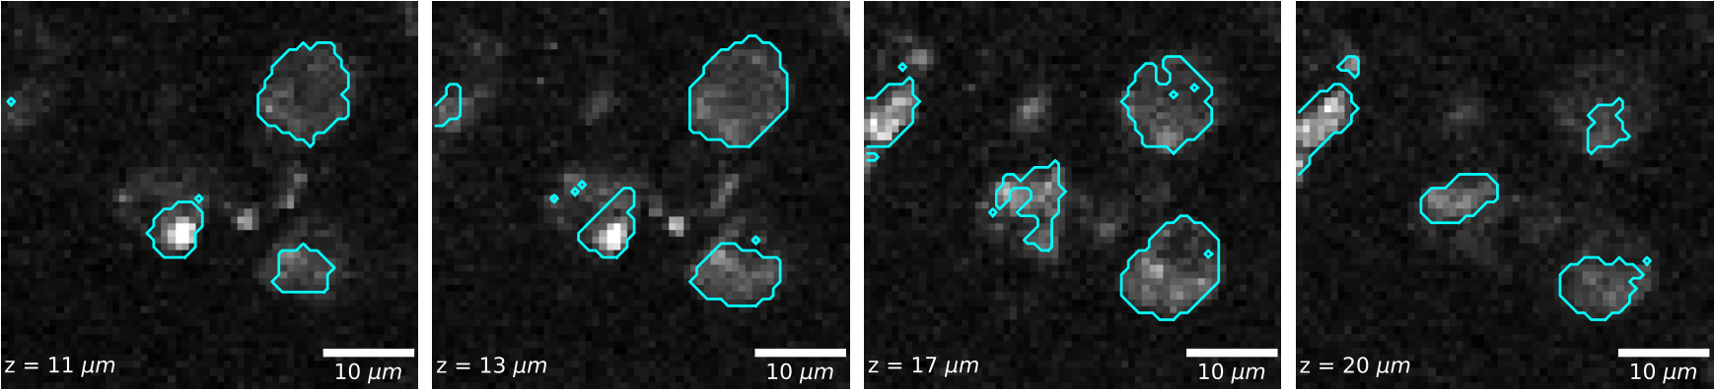
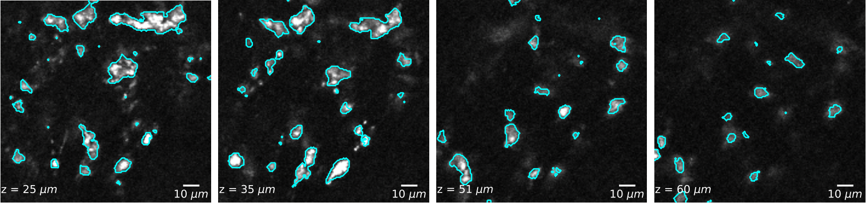
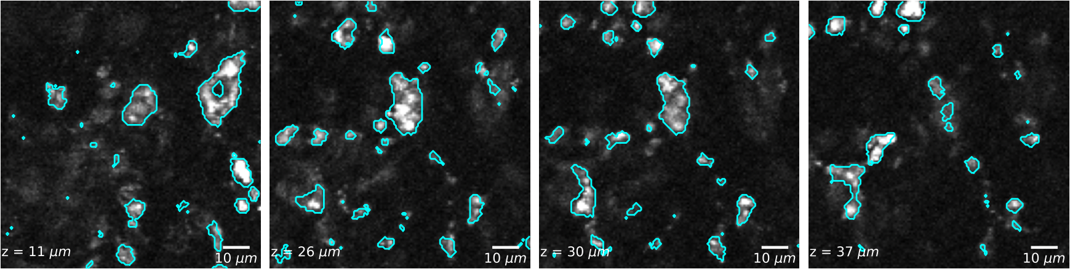
S1
S2
S3

Slide 10
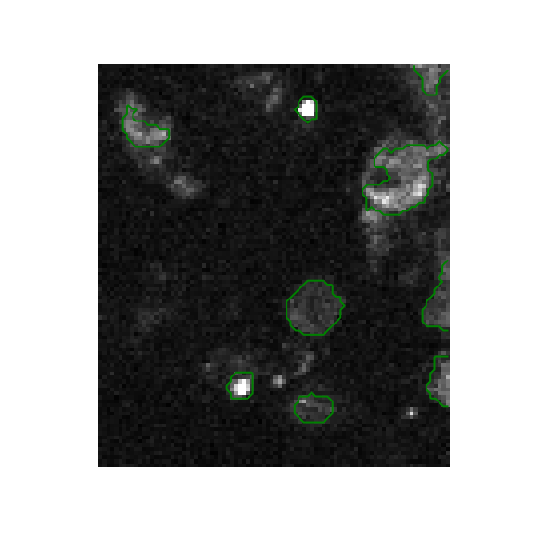
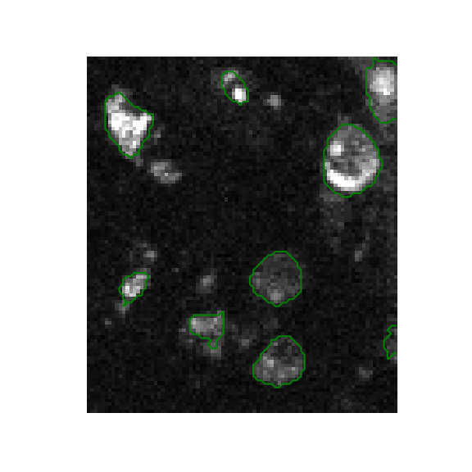
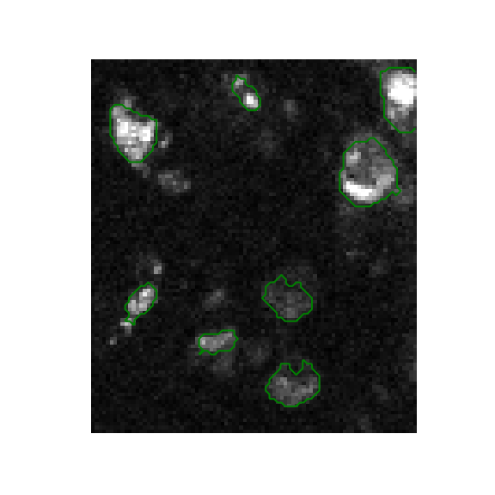
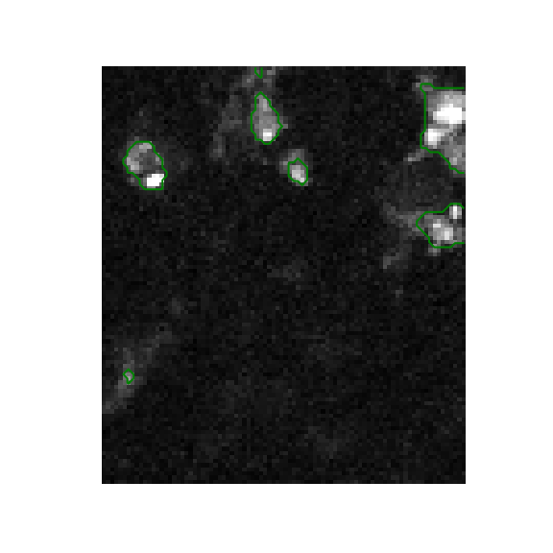
a₁
a₂
a₃
b₁
b₂
b₃
Z=8 µm
c₁
Z=10 µm
c₂
Z=13 µm
c₃
Z=15 µm

Slide 11
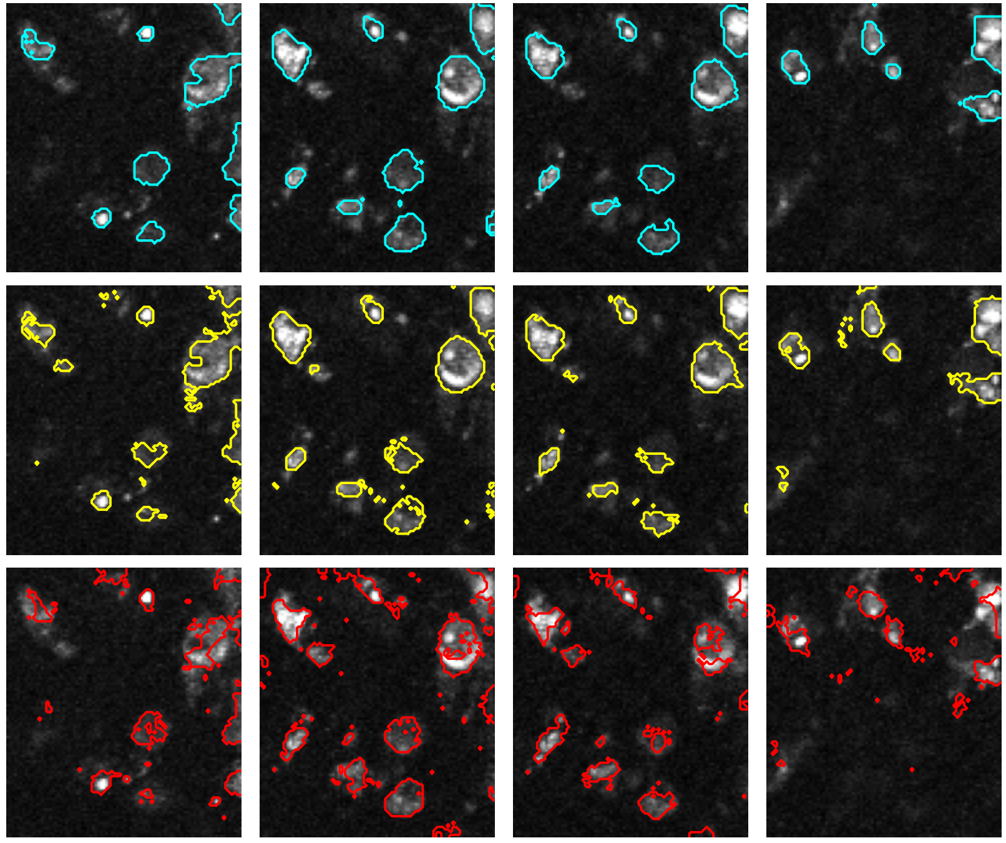
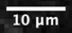
Z = 8 µm
Z = 10 µm
Z = 13 µm
Z = 15 µm
MeanVar, MaxMinMed, Laplacian
Mean, Variance
Derivatives

